Slide 1
Agent based modelling of microtubule dynamics
Presentation by Bettina Vignolo
Notes:
I‘m happy to be here today for my final presentation of my internship

Slide 2
Contents
Introduction
Microtubules, Agent based modelling
Methods
Microtubule Model, Data Analysis
Results
Parameter Analysis, Growth Rate, Catastrophe Events
Discussion
Outlook
Notes:
I structured my presentation like this
-So first, a quick introduction on the most important topics
-Then, I will shortly sum up the methods I used
-Next I want to focus on the results
-For the discussion I will point out some open questions and would love to hear your opinion on those
-And finally, I will give an outlook on what could follow

Slide 3
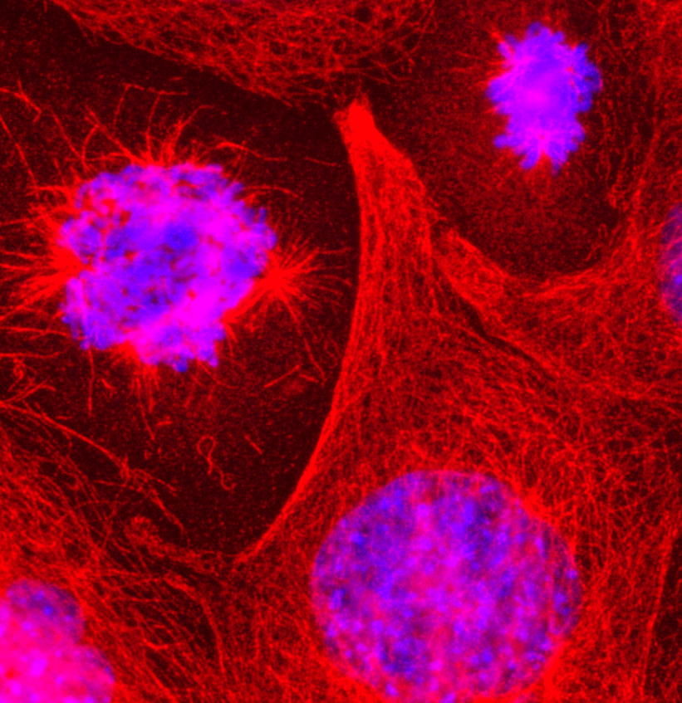
Microtubules – Structure and Function
I. Introduction
DAPI tubulin
Part of the cytoskeleton: stability, inner organization, motility of cells
Chain of tubulin protein dimers (α- and β-tubulin) build a protofilament
Tubulin has binding site for GTP / GDP
GTPase activity (hydrolysis of GTP to GDP)
13 protofilaments arrange as tube are called microtubulus (MT)
Vital cellular functions: chromosome segregation during mitosis, intracellular transport, cell structure
Microtubule-associated proteins (MAPs) influence dynamics
α
β
Protofilament
Microtubulus
Notes:
So first let me start with some general information on Microtubules
..
In the cell there are many so called MT-associated proteins and these are mainly responsible for regulating MT growth or depolymerization
But even without those MAPs, MTs have interesting growth dynamics …

Slide 4
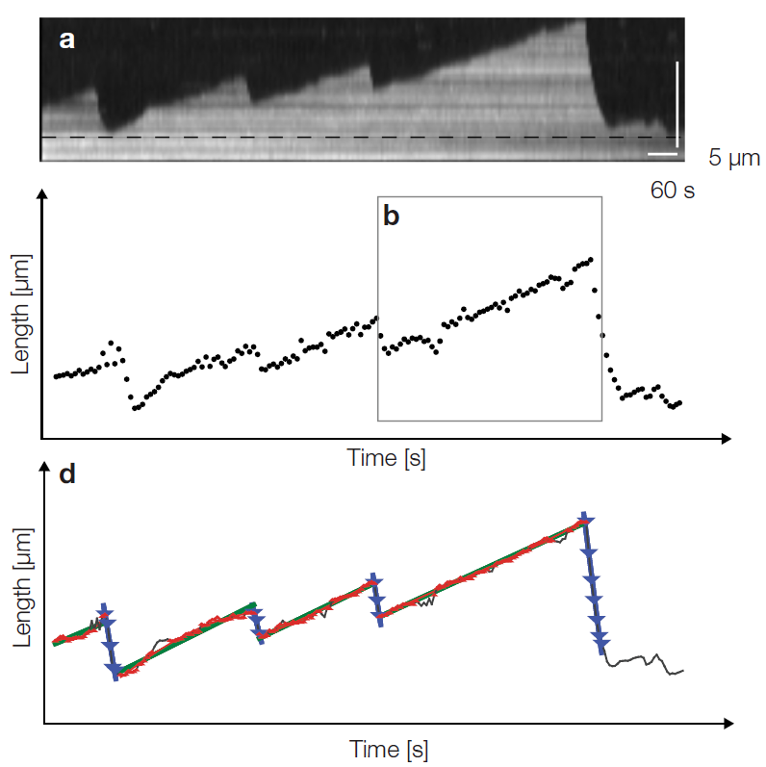
Microtubules – dynamic instability
I. Introduction
Tubulin is a GTPase (can hydrolyze bound GTP to GDP) -> leads to conformational changes -> influences dynamics
GTP-tubulin acts as “protective cap” (low probability to depolymerize)
Catastrophe events: determined by competition between growth rate and hydrolysis rate, leads to rapid depolymerization
Rescue: The moment when polymerization starts again after a catastrophe event
Kapoor et al. 2019
Notes:
Which leads me to the phenomenom called dynamic instability

Slide 5



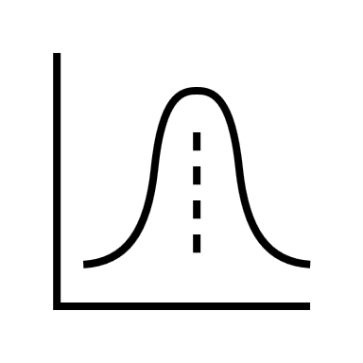


Agent based modelling in the study of MT dynamics
I. Introduction
Aims of this study:
To see if experimental data of MT dynamics can be reproduced with simple agent-based model and with only a few parameters.
To study the model and gain new insight into the influence of these parameters.
Notes:
But now coming back to my project…
the aim of this study…

Slide 6


II. Methods
II. Methods
Agents.jl package
Existing model created by Valentin
Small changes to existing model e.g. GTP exchange, syntax
Analysis of the model:
Parameterscan over 7-11 different values per parameter for: p_depolym_GDP, p_depolym_GTP, p_hyd, p_polym, p_GTP_exchange, numagents
Finding metrics for analysis: growth / catastrophe rates, frequencies, velocities
Notes:
This leads me to the methods I used to answer these questions

Slide 7
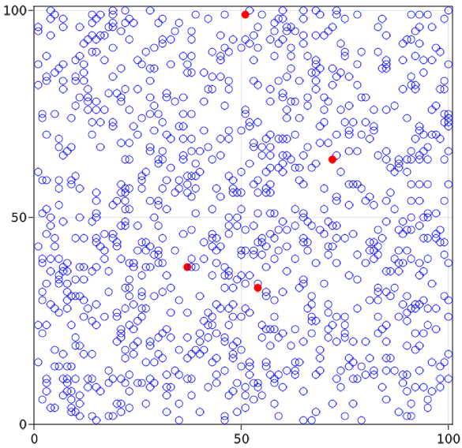
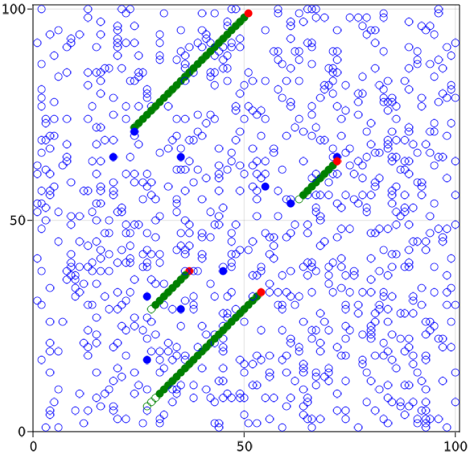
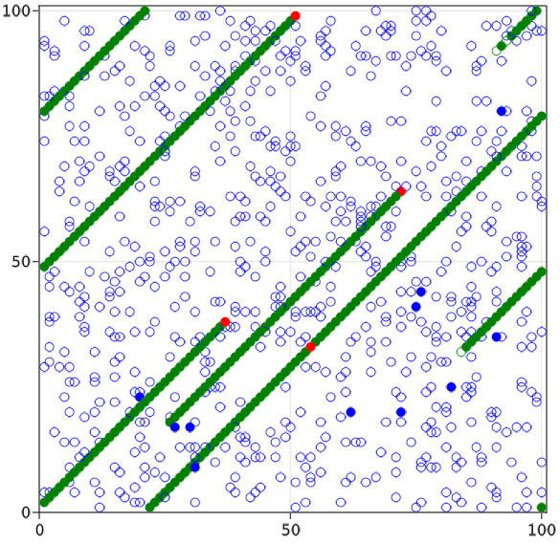
The agent-based microtubule model
II. Methods
Initialize model:
Agent_step! (1.000 steps)
Agent_step! (10.000 steps)
Parameters:
Nstarts: number of starting points (here: 4)
Numagents: number of free agents (here: 1000)
Dimensions (here: (100, 100))
Probabilities: p_polym, p_hyd, p_depolym_GDP, p_depolym_GTP, p_GTP_exchange
(here: 1.0, 0.024, 0.2, 0.0, 0.01 respectively)
GTP | GDP
 |  | Starting points
 |  | Free tubulin
 |  | Polymerized tubulin
Collected data:
Mean MT length

Slide 8
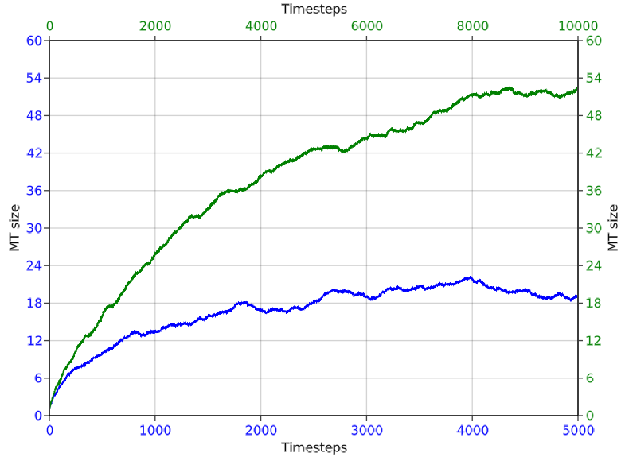
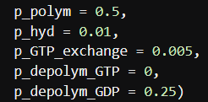
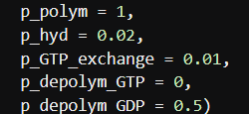
The parameter are not coupled
III. Results
Comparing 30 ensembles of two models with same dimensions, numagents, Nstarts
But: for one model all the probabilities are half as high as in the other model and it runs twice as long
Doubling parameter seem to have stronger effect on catastrophe as on growth

Slide 9
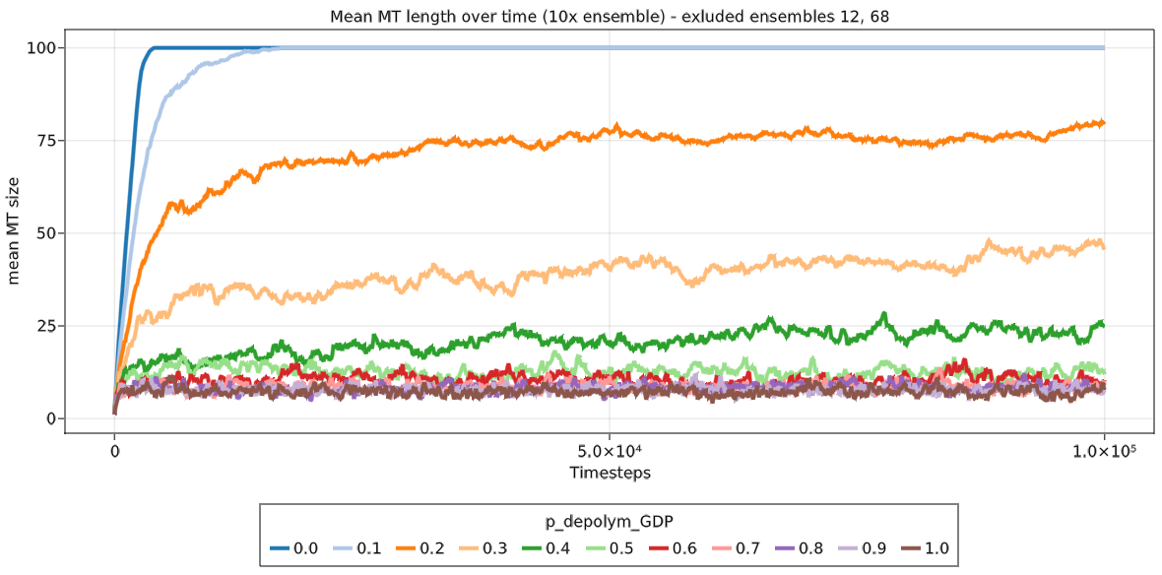
Parameterscan – Part I
III. Results
Parameter scan over 100.000 steps and 10 ensembles per parameter value (10-11 different values per parameter)
Model with 4 Nstarts
Ensembles were excluded in which 2 starting points were seeded in same diagonal and thus not allowing the MTs to reach maximum length

Slide 10
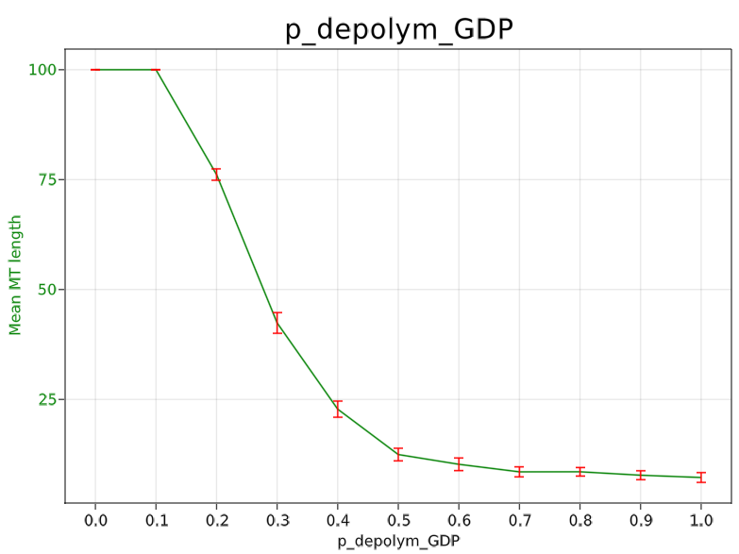
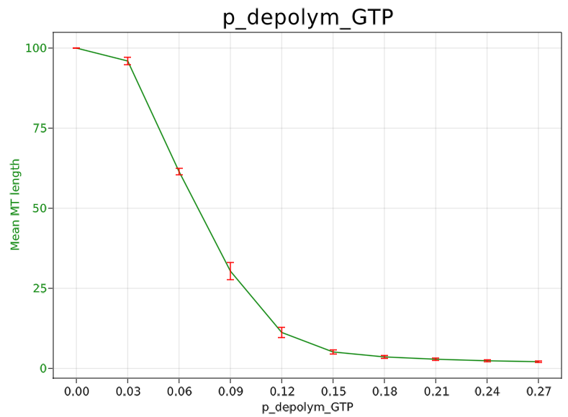
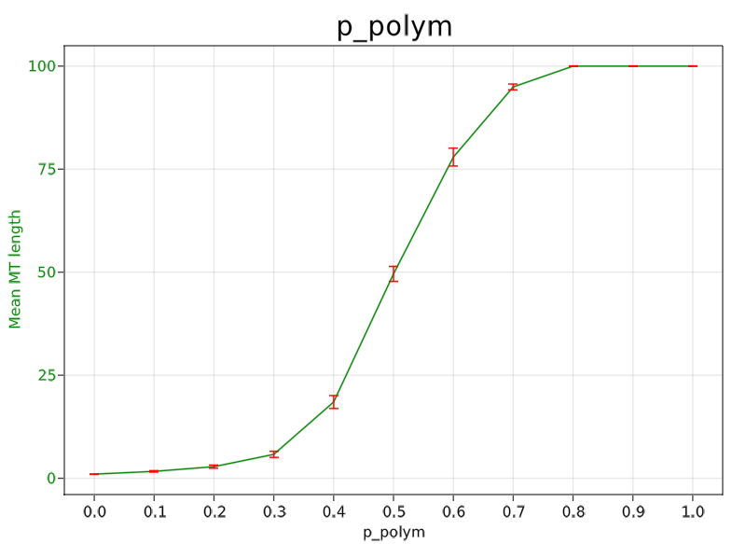
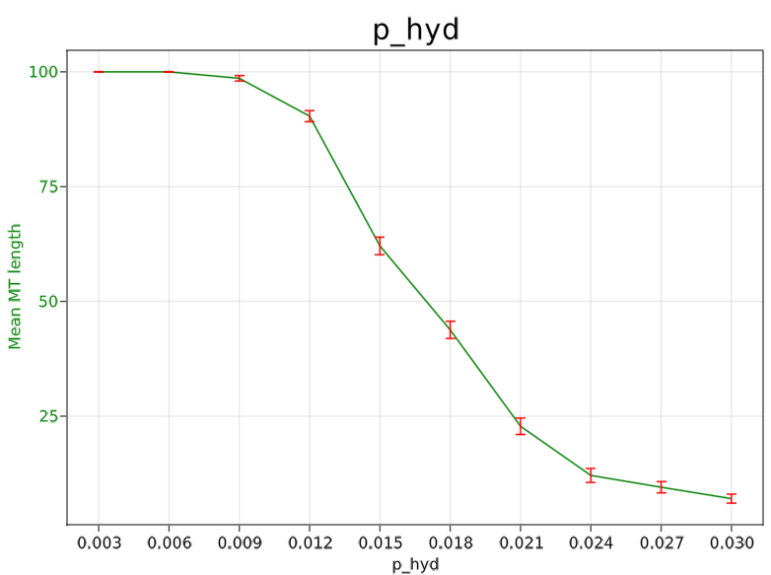
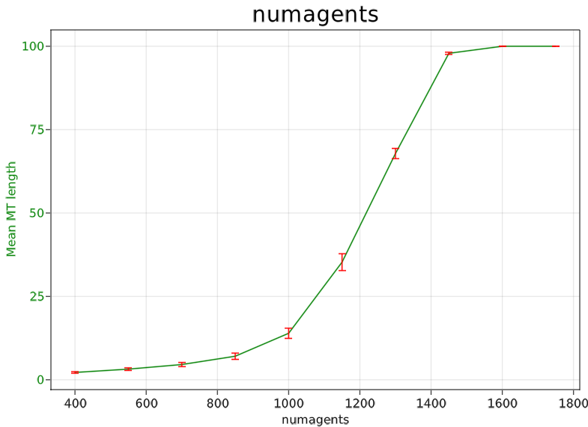
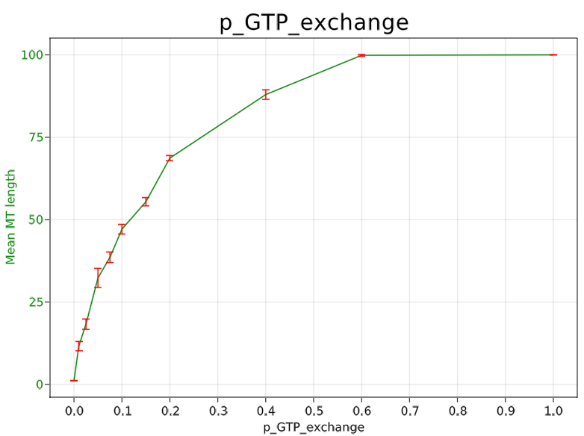
Parameterscan – Part II
III. Results
(p_depolym_GDP = 0.1)
(p_depolym_GDP = 0.1)

Slide 11
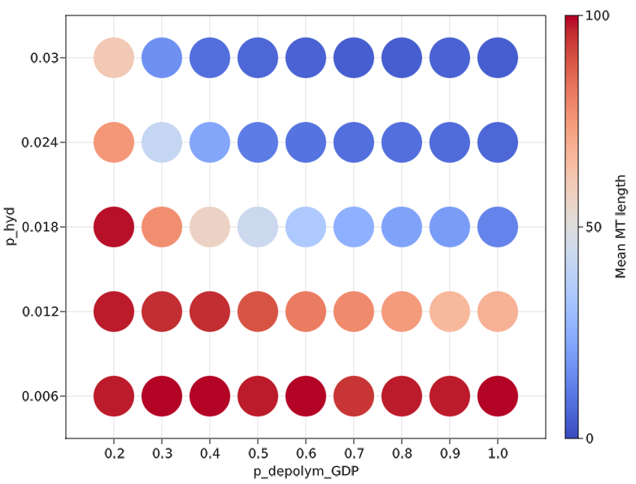
Parameterscan – Part III
III. Results
Phase diagram to compare 2 parameters directly with each other
Only done for p_hyd and p_depolym_GDP
Smaller changes in p_hyd lead to greater differences in Mean MT length
Possible explanation: p_hyd has direct influence on catastrophe rate while p_depolym_GDP can only influence depolymerization if and when a catastrophe event happens

Slide 12
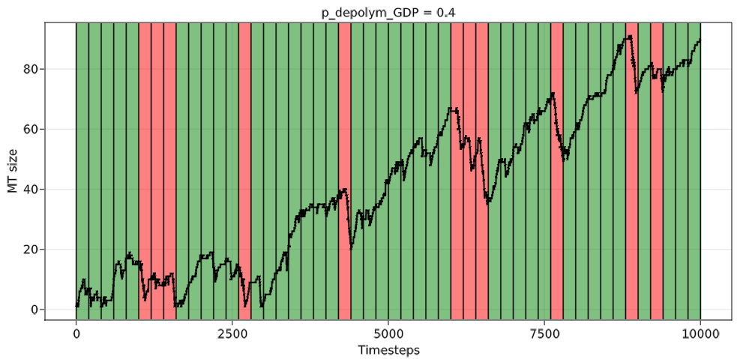
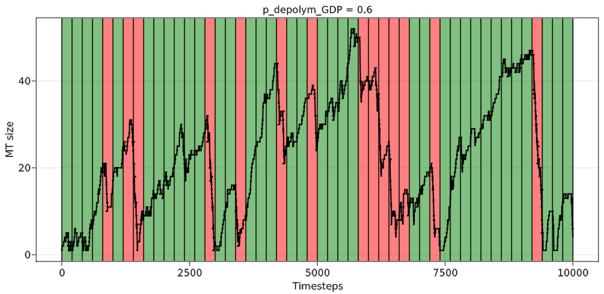
Calculation of Growth and Catastrophe Rates
II. Methods
Growth rate: number of tubulin agents added to the MT per step (can be either +1, 0, -1)
Growth classification: data divided into 200-step sections and each section classified into “growing”, “shrinking” or “not changing”
Groups: sections next to each other with the same growth classification are grouped
Growth velocity or catastrophe velocity is calculated for each “growing” or “shrinking” group by calculating MT min / max and Δ step
Mean growing velocity and catastrophe velocity calculated of all groups in one model
Notes:
Now moving on to another metric

Slide 13
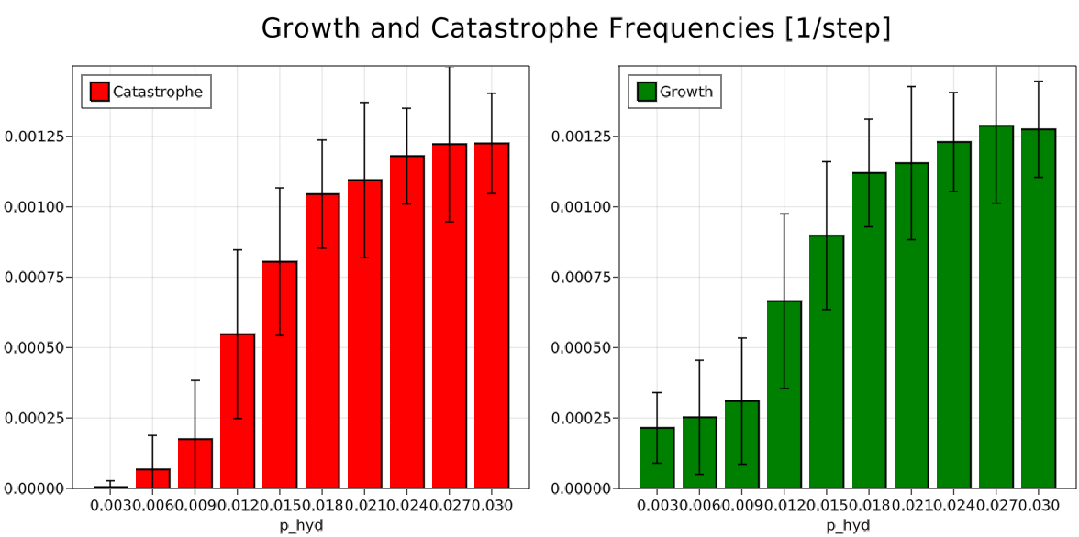
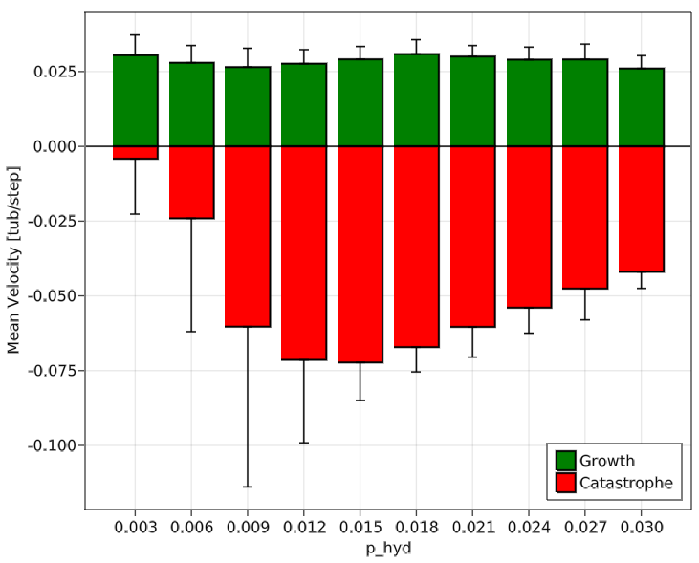
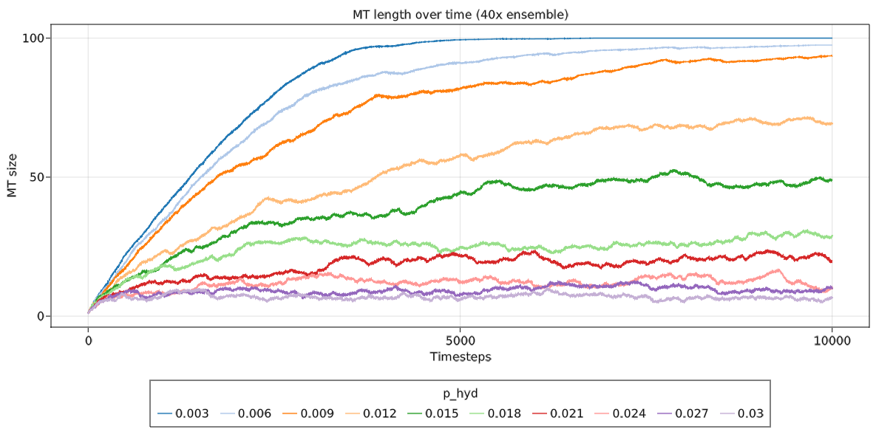
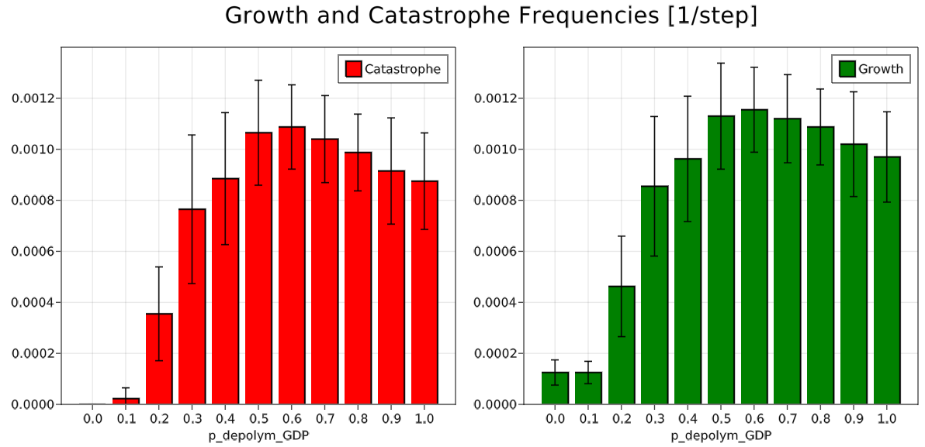
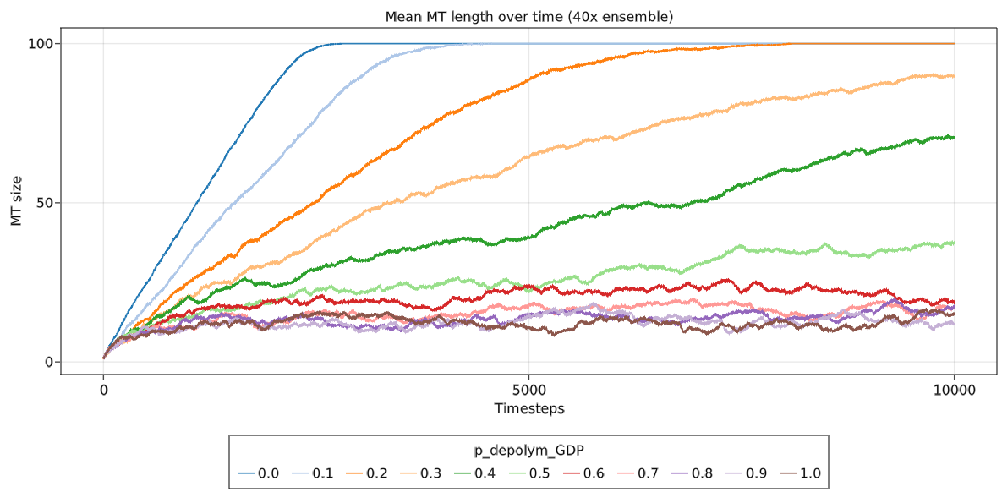
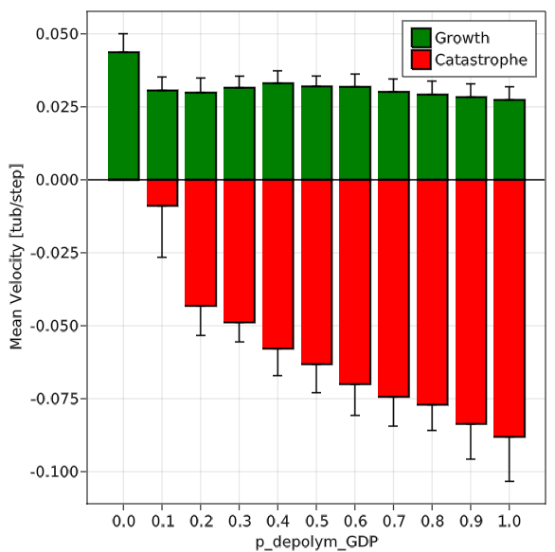
Growth and Catastrophe Velocities
III. Results
p_hyd:
Velocities
p_depolym_GDP:
Velocities

Slide 14
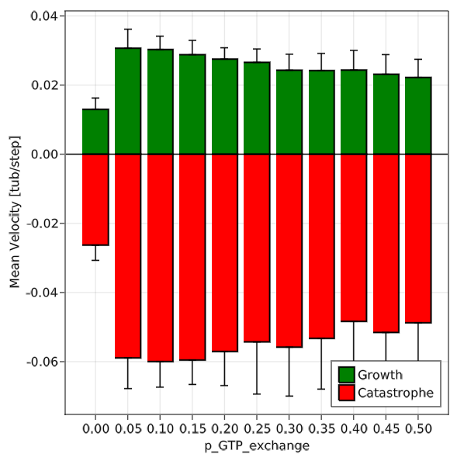
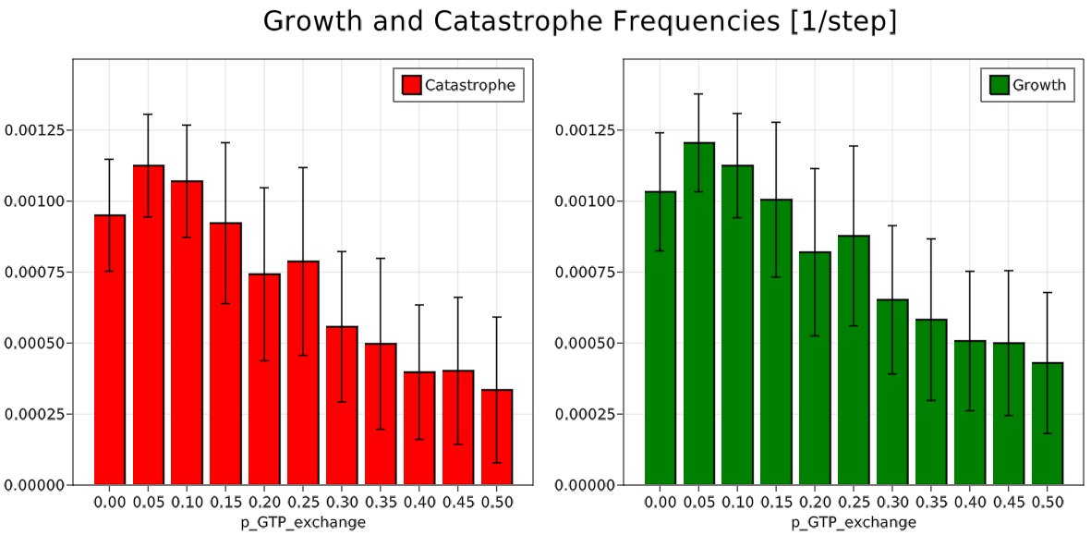
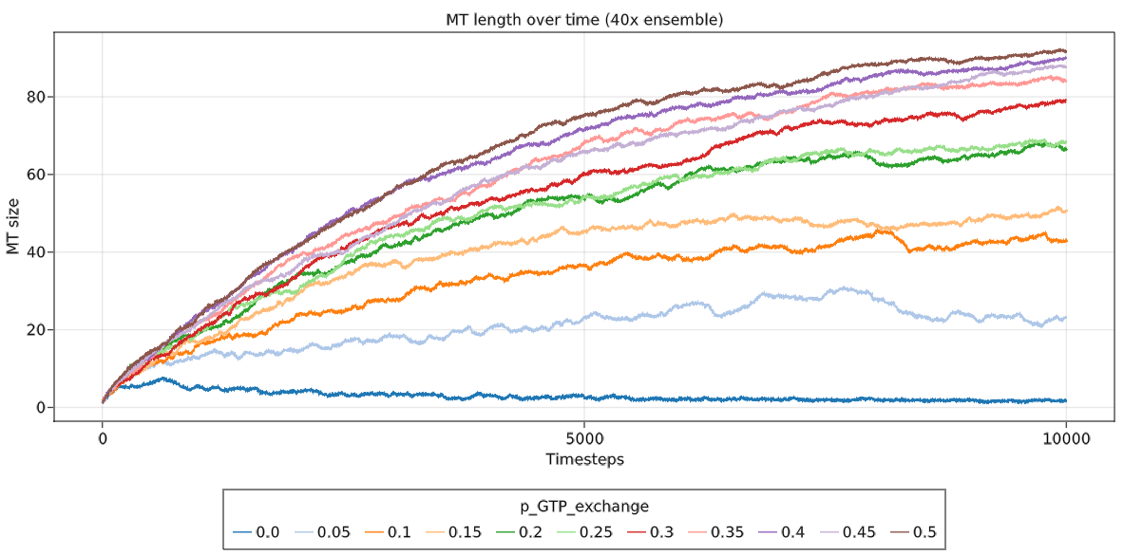
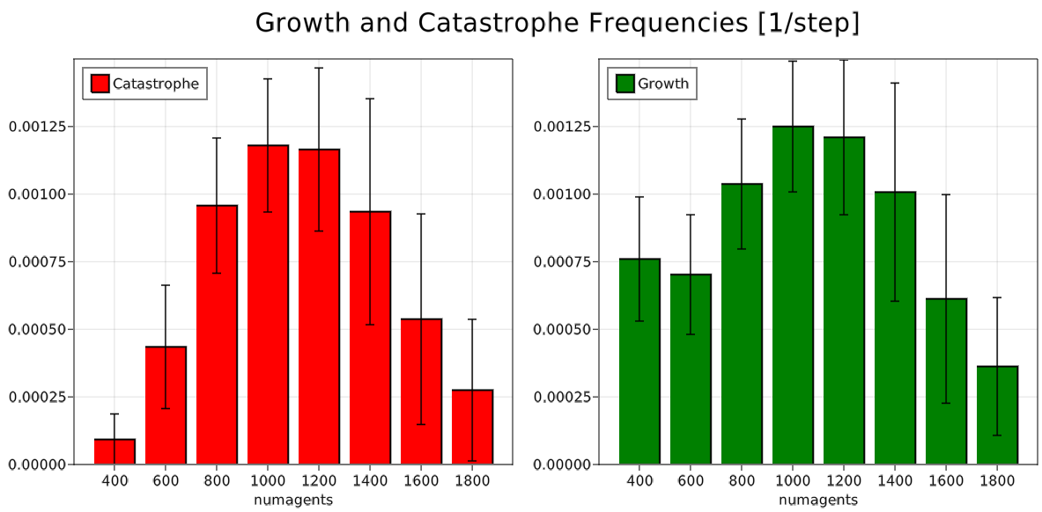
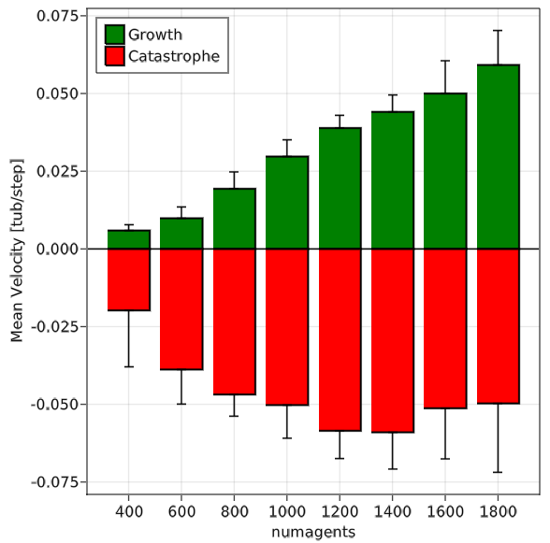
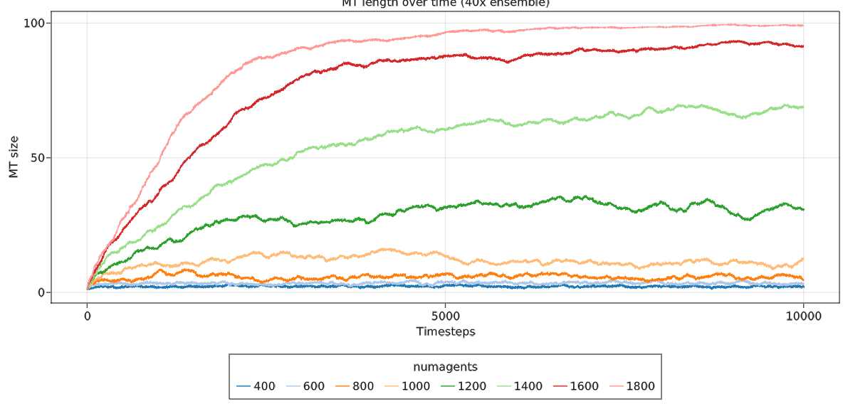
Growth and Catastrophe Frequencies
Velocities
p_GTP_exchange:
Numagents:
Velocities

Slide 15
IV. Discussion
IV. Discussion
Summary
Open questions
Parameter are not coupled
Parameterscan shows different effects on the model
Some parameters only influence growth or catastrophe events others influence both -> interesting to analyze these separately instead of mean MT length only
What kind of metric should be used to compare different models?
Can the calculation of growth and catastrophe velocities be improved?
Is the model representing reality?
How could performance be improved?
Notes:
To sum it all up….
-I think the model does what it’s supposed to do
-even with my method you can see that some …
-> so the open questions remain
Moreover, ..

Slide 16
V. Outlook
V. Outlook
Improving the calculation of growth rates and catastrophe events
Finding best metrics
Comparing model data with experimental data
Extent the model to be more “realistic”:
Different growth directions
Model in 3D
Notes:
This leads me to the outlook and future experiments which will or could follow now
-First
-Next
-As proof of principle
-Another very important aspect to analyze
-And finally, it would be great if …
These are just a few ideas but of course

Slide 17


Thank you for all your help and ideas during this internship!
And thank you for your attention ☺
Any questions?
Notes:
So thank you very much for listening and now I would be happy to answer you questions or hear your comments

